Slide 1
Assignment Review
University of Suffolk
Context of Business
Deadline: 4th April 2022

Slide 2
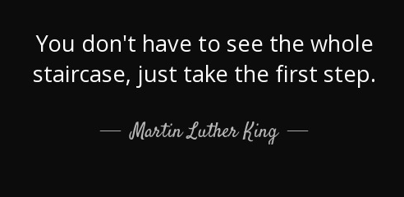

Before you start

Slide 3
Task
For this assignment, choose one company from
Marks and Spencer
JD Sports
Primark
Zara
Perform a SWOT and PESTEL analysis for your chosen company.
From the analysis in task 1, in your opinion, how has the covid-19 and Brexit have influenced the company of your choice? Critically analyse the strengths and weaknesses you identified in task 1 impacting the opportunities and threats from the environmental factors as direct result of Covid-19.
Recommend a suitable leadership style that will suit the company. Justify your choice using appropriate literature and examples.
Critically comment on their Corporate Social Responsibilities in the processes using evidence from your research.

Slide 4

SWOT Analysis
QUESTION 1: Perform a SWOT and PESTEL analysis for chosen company.
Strengths
What are the internal Strategic factors that even their competitors consider to be their positives
Example:
A strong and easily recognisable brand name

Slide 5

SWOT Analysis
Weaknesses
What are the internal Strategic factors that is holding them back
Example:
An easily imitable business model

Slide 6

SWOT Analysis
Opportunities
What are the External Strategic factors that can provide new openings and advantages
Example:
new locations, partnerships

Slide 7

SWOT Analysis
Threats
What are the External Strategic factors that can be dangerous for the business
Example:
competitors

Slide 8
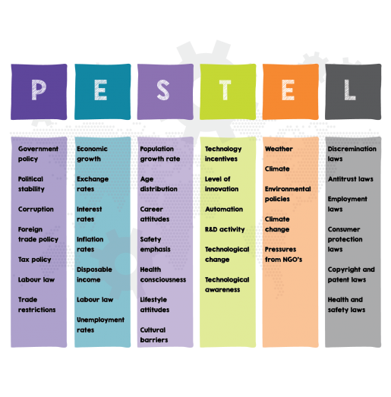
PESTEL factors

Slide 9
Presenting the ideas
SWOT Factors
Strengths
* Well-known Brand: The company has presence in over….
* Financially Strong: ….
Weaknesses
….
Same with PESTEL
OPPORTUNITIES | THREATS

Slide 10
SWOT Example for EasyJet
STRENGTHS | WEAKNESSES
Well-known Brand name. The company has presence in over 20 countries (Easyjet, 2021) Financially Strong with operating profits over £20 million in 2020 despite covid pandemic (Butler, 2022) New fleet comprising 20 new Boeing 797 aircrafts | Poor reputation of Customer care Growing dissatisfaction among staff over pay and working conditions (Butler, 2022) Poor reputation on weak CSR and negative image on carbon footprints
OPPORTUNITIES | THREATS
New market opportunities in Jordan, Egypt, Albania and Tunisia (EasyJet, 2021) Strategic Partnerships with Hilton Hotel group Post covid market growth expectations | Brexit affecting landing rights in EU airports Dissatisfaction among customers over cancellations and delays (Butler, 2022) Competition from other low cost airlines and large carriers like BA and Lufthansa Increase in energy price including Aviation Fuel affecting margins (Hall, 2022)

Slide 11
Question 2: From the analysis in task 1, in your opinion, how has the covid-19 and Brexit have influenced the company of your choice? Critically analyse the strengths and weaknesses you identified in task 1 impacting the opportunities and threats from the environmental factors as direct result of Covid-19.
You need to show the link between SWOT and PESTEL
You will find relationship between Opportunities and Threats with PESTEL in direct / indirect relation to COVID-19 and Brexit
Example
Economic opportunities
Economic threats
Technology opportunities
Social threats
This you present in paragraphs

Slide 12
Question 3: Recommend a suitable leadership style that will suit the company of your choice Justify your choice using appropriate literature and examples.
You need to discuss the leadership style with application of theory and evidence through suitable examples.
For example :
Describe Commanding theory and its characteristics, and apply to chosen company how it would suit, with examples (linking to SWOT ad PESTEL factors identified will get more marks).
DO NOT USE Great Man Theory, Traits Theory, Behavioural theory

Slide 13
Question 4: Critically comment on their Corporate Social Responsibilities in the processes using evidence from your research Comment on the responsibility, response and obligations in their ethics and social responsibilities in the processes at the company using evidence from your research.
Find some CSR actions / activities and discuss them as
Responsiveness
Responsibility
Obligation

Slide 14
Structure
Cover page
Executive Summary (100-200 words)
Table of Contents
Introduction (including the company profile ) -100-200 words
Question 1 to 4 – appropriate word count as indicated in brackets
Conclusion (100-200 words)
References
SWOT / PESTEL can be in paragraphs or table or entirely bullet points
Assignment should have evidence of reading, understanding, and application of theories
NOT INCLUDED IN WORD COUNT
-- NOT INCLUDED IN WORD COUNT
Deadline: 4th April 2022
Max word count 3000 words

Slide 15
Cover page
University NAME
Context of Business
<Company> Case Study
Name
ID

Slide 16
Sample Table of contents / layout

Slide 17
Submitting Assignment

Slide 18
Submitting Assignment

Slide 19
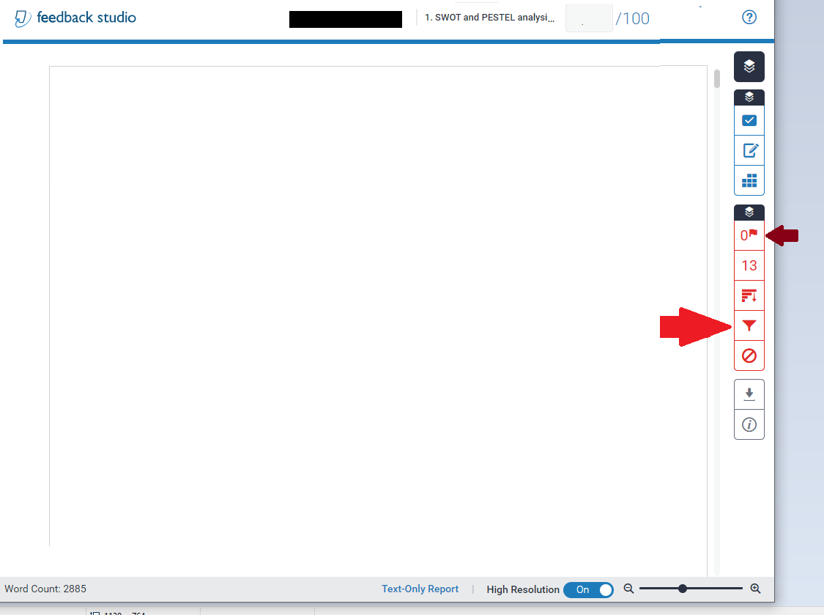
Flags assignments suspected of done by third parties or using hidden codes
Click on filter symbol for filter out bibliography

Slide 20
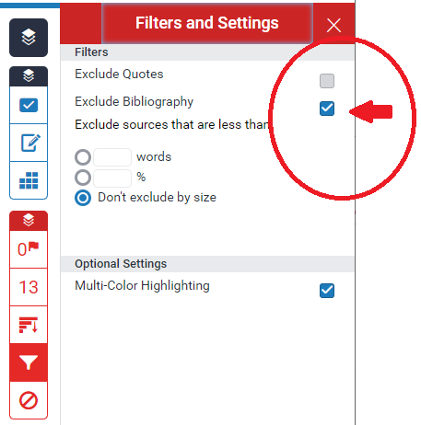

Click on filter symbol for filter out bibliography

Slide 21
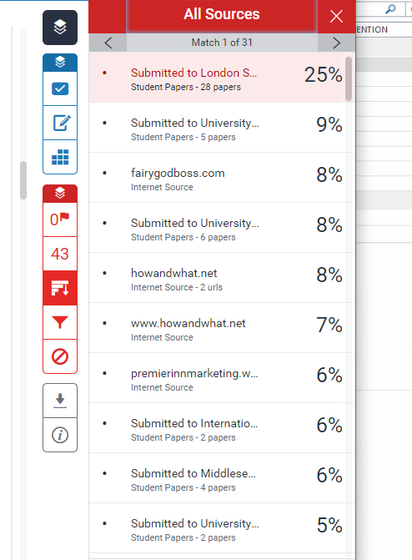
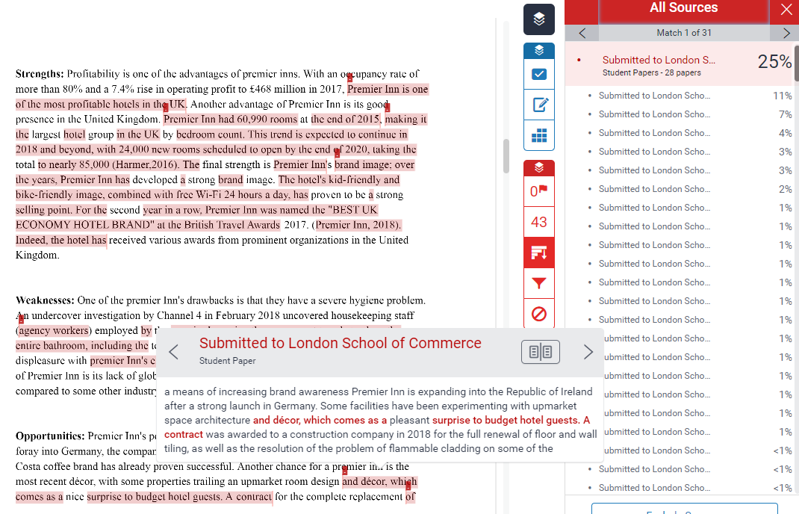

Slide 22
FAQ
Number of references –at least 6
References should be Harvard referencing
Executive Summary mandatory
Table of Contents – compulsory
Headings need not be numbered
Text – normal font size – Times New Roman size 12. Calibri or Garamond accepted. No other fonts acceptable.
Layout must be clear and consistent. 1.15 spacing or 1.5 spacing fine.
Minimum 2500 words – maximum 3000 words. Not more – not less

